Slide 1
Introduction to Amazon AWS
Brian Korzynski

Slide 2





































Platinum Sponsors
Gold Sponsors
Silver Sponsors

Slide 3
About Me
Owner of Korzynski LLC
Independent Consultant for 3+ years
http://www.korzynski.com
Professional Developer for 7+ years
Windows Forms
Web
Mobile
SQL Optimization
Data Analysis
Mathematics
Big Data
Cloud

Slide 4
Cloud in General
Secure
Durable
Highly-Scalable
Highly-Available
Pay only for what you use
No minimums or setup fees

Slide 5
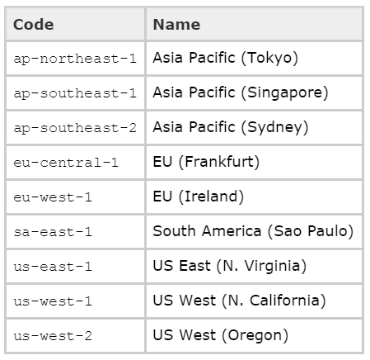
Regions
Physical locations of the Amazon data centers
Today I will be using the Oregon data center (us-west-2)

Slide 6
Before We Begin
Console
Identity & Access Management (IAM)
Gives the .Net SDK access to the services
NuGet Package
Old Way – AWSSDK
New Way – AWSSDK.Core +
AWSSDK.S3
AWSSDK.SQS

Slide 7
S3
File and blob storage
Key Value store of any object type
Uses containers called Buckets, think of these as folders within a file system
However you cannot nest buckets
Costs about $.03 per GB of data stored + $.005 per 1,000 requests
My S3 with 100,000+ documents runs me about $.10 a month
Demo

Slide 8
SQS
Queueing service
Supports simple and more advanced queueing strategies (e.g. topics)
Messages must be serialized to a string
Max message size = 256kb
Max number of messages = how ever big your wallet is
Costs about $.09 per GB (after the first GB which is free) for outbound and all inbound is free
My SQS with around 30,000 messages at a time runs me about $.05 a month
Demo

Slide 9
SNS
Push Notification Service
Mobile devices
Email
Other Distributed Systems
Pricing:
Mobile - $.50 per million
SMS - $.75 per 100
Email - $2.00 per 100,000
HTTP - $.60 per million
SQS – free
My SNS is free since I utilize less than 100 SMS and less than 1,000 emails per month
Demo

Slide 10
SES
Outbound only email sending service
Very useful when sending out massive amounts of emails
Gets around spam filtering
Tracks bounce backs
Pricing:
$.10 per thousand
$.12 per GB of attachments
My SES costs be $.22 a month since I am sending emails with several attachments

Slide 11
EC2
VM’s
You can do what ever you want, however you have to manage the IT side e.g. updates

Slide 12
Pro Tips
Name your buckets, queues, topic etc. with only lower case letters
This has caused problems for me in the past
If you need to store large amounts of data within a queue to process then store the object in S3 and only add the bucket and object name (concatenated) to the queue
When storing large amounts of serialized data (strings) in S3 I would recommend you compress them to save space and money
Prefer services (i.e. SQS, S3, SNS, etc.) to VM’s
This way they handle the updates and scaling
When possible keep all of your services within the same region, as this cuts down on latency
Don’t be afraid to experiement Amazon AWS is incredible cheap (especially compared to Azure) and most of the time you will fall into the free tier
All of my Amazon costs me about $.50 per month

Slide 13
Questions
http://www.github.com/korz
@bkorzynski

